Slide 1
Hour 7
Using Conditional Tests to Make Decisions

Slide 2
Review
Last time we learned about Strings and what you can do with them
Print lines
Special characters
Concatenate Strings
Compare Strings
Find the length of Strings
Change the case of Strings
Find Stings within Strings

Slide 3
Review
Keywords
class
extends
final
import
public
static
void
Special characters
( )
{ }
[ ]
Operators
=
+
-
*
/
%
++
--
+=
Types
boolean
byte
char
double
float
Graphics
int
long
short
String
API Calls
Double.parseDouble()
Graphics.drawString()
Integer.parseInt()
Math.sqrt()
String.equals()
String.indexOf()
String.length()
String.toLowerCase()
String.toUpperCase()
System.out.print()
System.out.println()

Slide 4
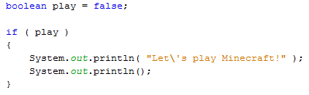
if Statements
if statements check if a condition is true
When the condition is true, the program will do whatever is inside the if statement block
When the condition is not true, the program will not execute the commands inside the block

Slide 5
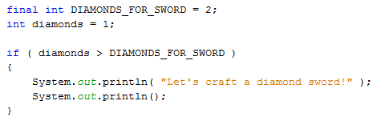
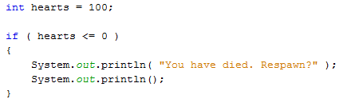
Less Than and Greater Than Comparisons
Less-than (<) and Greater-Than (>) operators can be used inside an if conditional
Less-than-or-equal-to (<=) and Greater-than-or-equal-to (>=) operators can also be used inside an if conditional

Slide 6
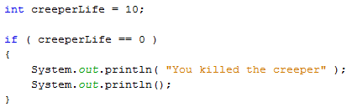
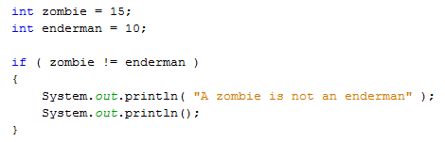
Equal and Not Equal Comparisons
Equal (==) and not-equal (!=) operators can also be used inside an if conditional

Slide 7
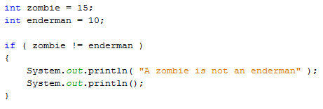
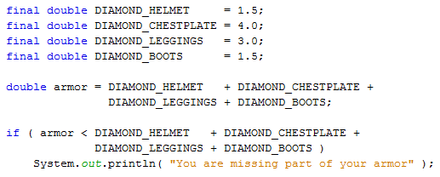
Organizing a Program with Block Statements
Curly braces allow multiple lines to be associated with the if statement
Without curly braces, only one line will be associated with the if statement

Slide 8
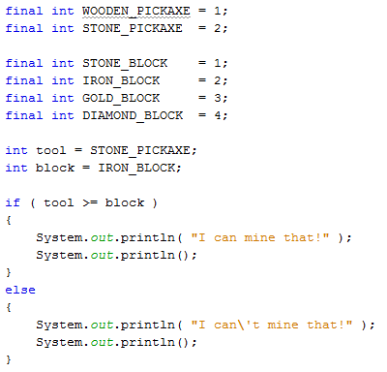
if-else Statements
If you want to do one thing if the condition is met and a different thing if the condition is not met, use an “else” statement

Slide 9
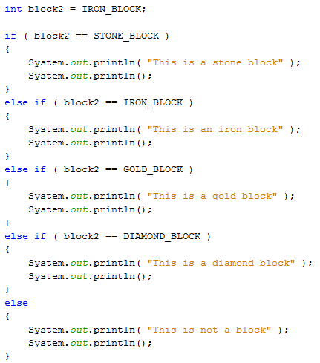
else if Statements
If you want more than 2 alternatives, the “else if” statement can be used:

Slide 10
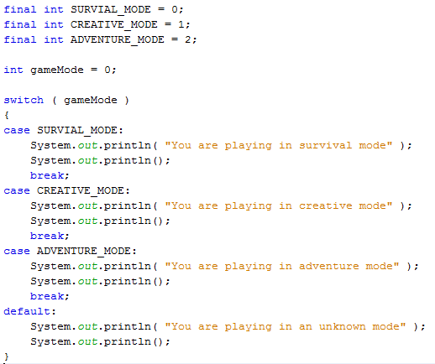
switch Statements
Instead of a long series of “if…else if…else” statements, you can use a “switch…case” statement:
default is selected if no other case matches

Slide 11
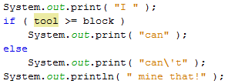

The Conditional Operator
A very condensed way of writing an “if…else” statement like this:
Is to write it like this:
This is called a conditional operator or a ternary operator

Slide 12
Watch the Clock
See the example on pages 88-89, which puts all this together

Slide 13
Summary
We learned about conditional statements
if
else
else if
switch/case/default

Slide 14
Questions

Slide 15
Homework
Read the pages 87-91 (Watch the Clock)
Copy the program and run it
Make sure you understand how each section works
Change your SecretWord program so that:
Instead of printing “Match=true” or “Match=false”
Make it print:
“You guessed the secret word!”, or
“Sorry, try again!”

